Slide 1


Sparrow Platform

Slide 2
Content
1. Background
2. Sparrow overview
3. How Sparrow works
Sparrow Net
Sparrow AI
Sparrow Applets ecosystem
4. Contributing to Sparrow platform
5. Join the community

Slide 3

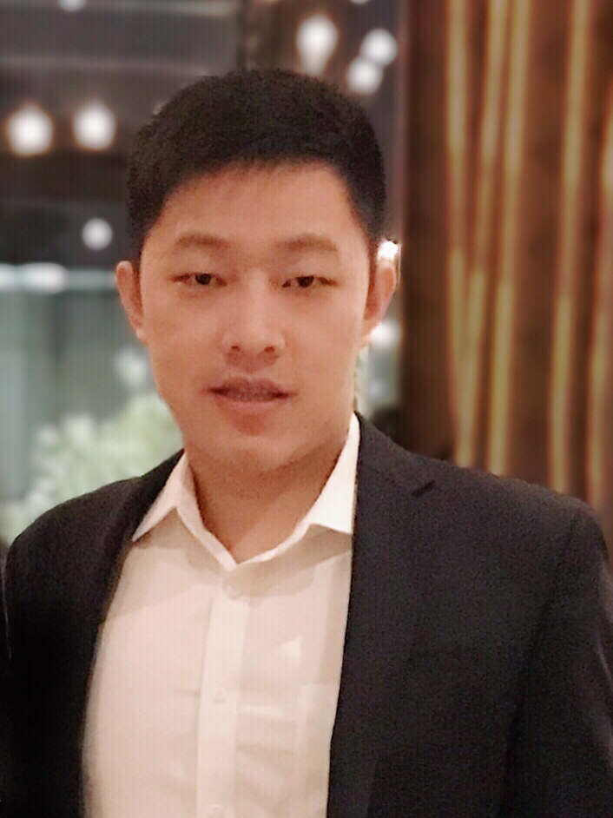
Who are we?
Jay Lohokare
Senior Digital Analyst
MDL - Data engineering
Sheng Chen
Digital Analyst
MDL – Product engineering

Slide 4
Background

Slide 5







Sparrow Platform was runners up at CallforCode 2019
Hackathon
Co-creation
Deployment
Community
250 Million dollars initiative lead by

Slide 6
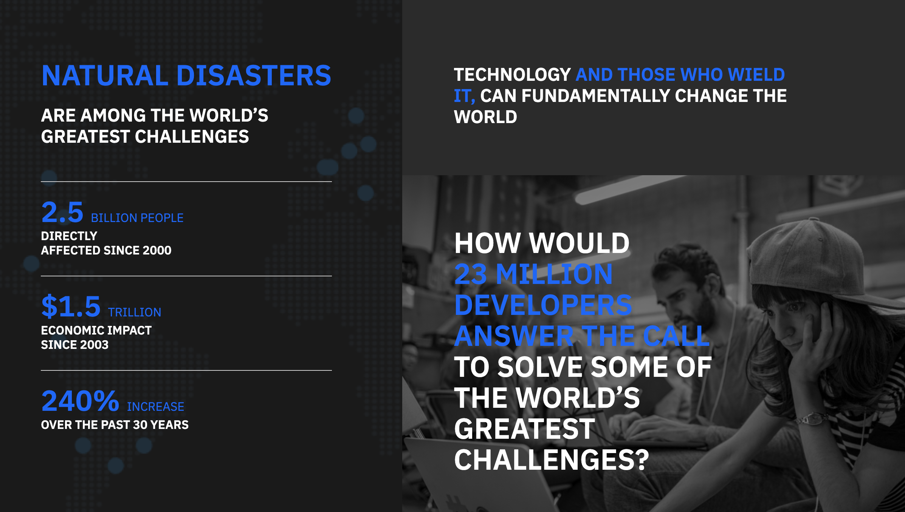
CFC is a multi-year initiative for technology driven natural disasters recovery

Slide 7
Why are we talking about Sparrow now?
Give a real-life opensource IoT-Cloud-AI use case walkthrough
Evangelize Sparrow platform – Build Sparrow community

Slide 8
Overview

Slide 9
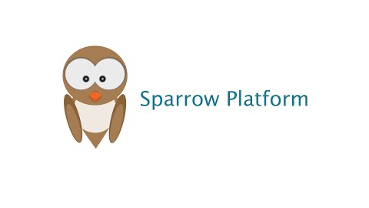

Slide 10
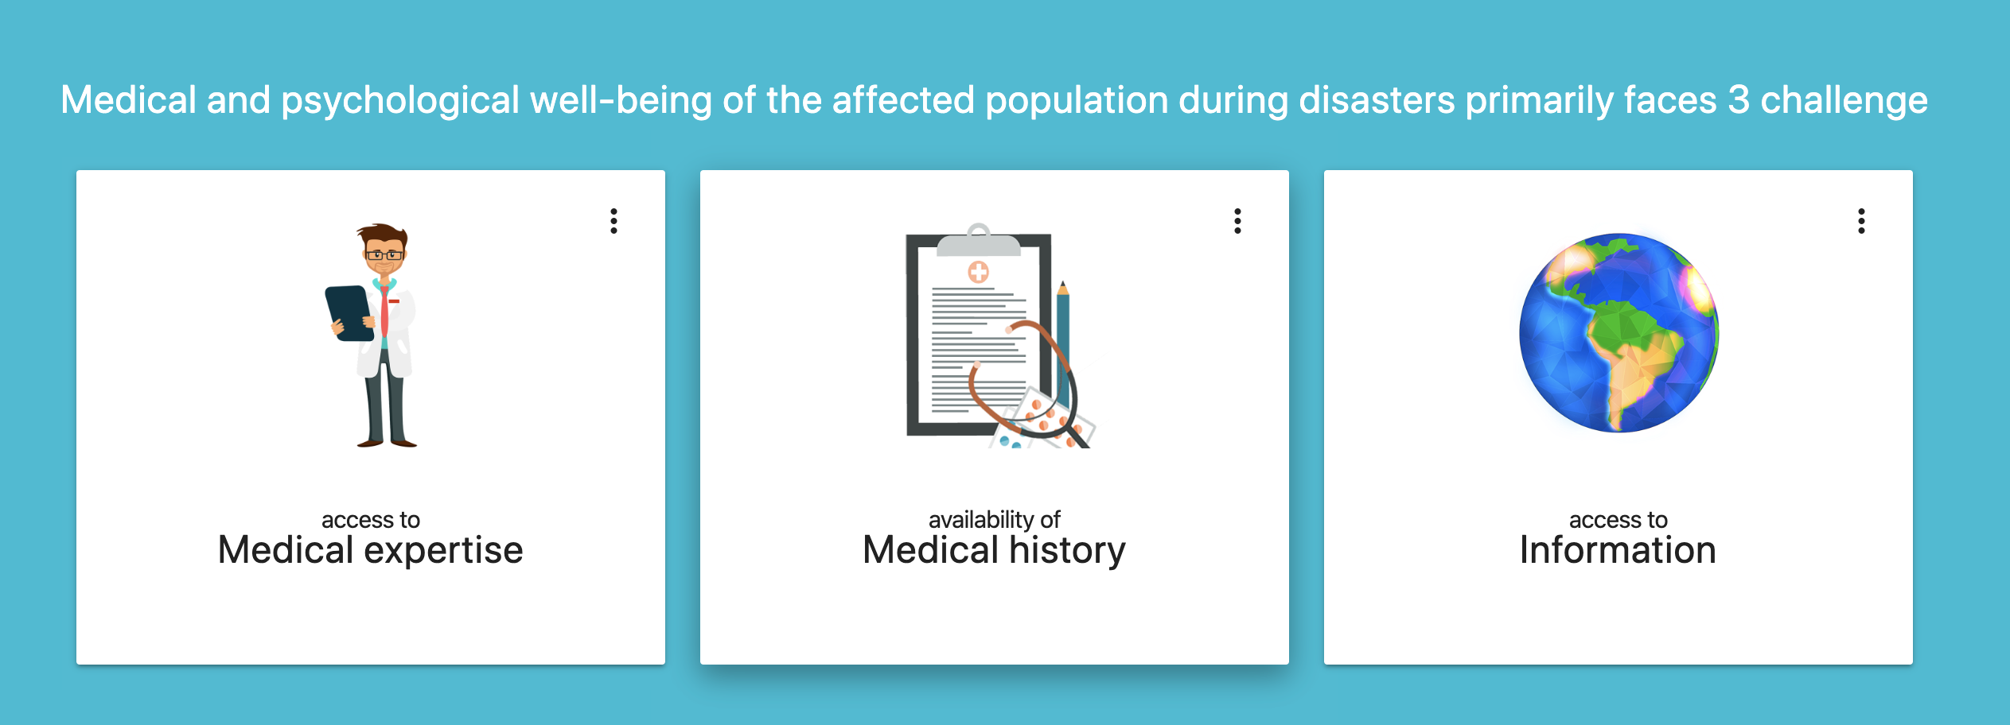
The ‘Problem statement’

Slide 11
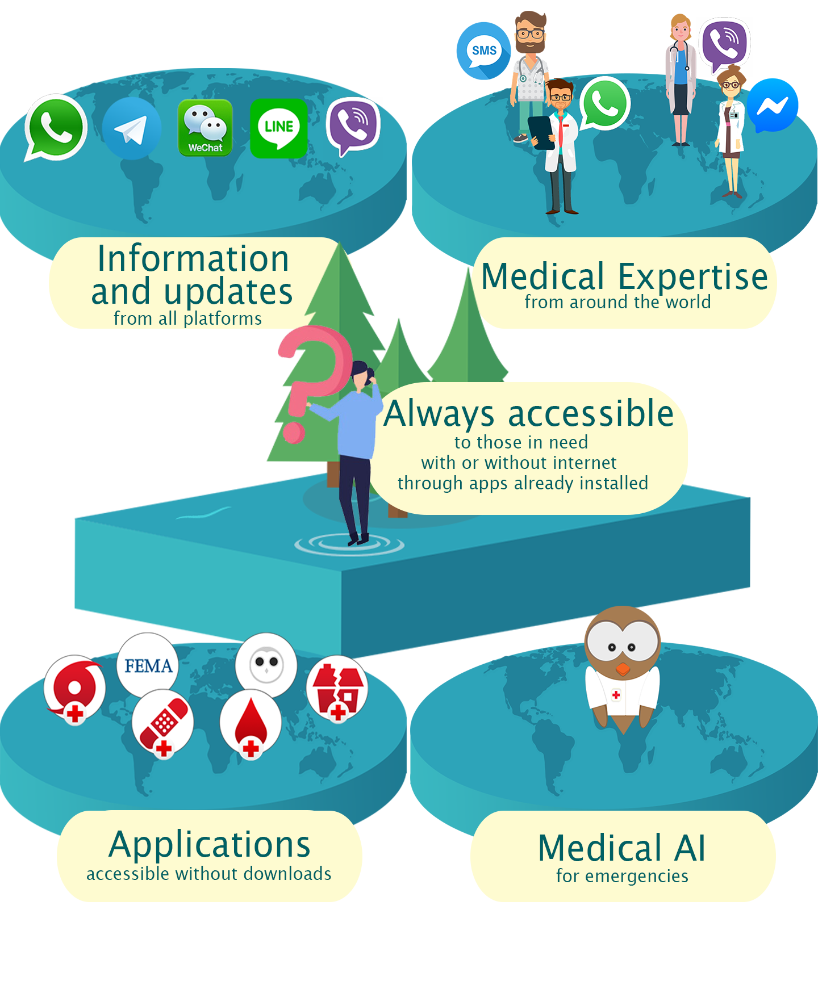
Sparrow Platform overview

Slide 12
What does Sparrow do?
Sparrow connects disaster victims and first responders to doctors around the world.
Imagine Uber like system where doctors / medical experts can signup and get connected directly with those in need of medical help
2. Sparrow ensures Information and Applications are always accessible
Like Alexa / Google assistant

Slide 13
What’s unique about Sparrow?
No need to install new applications
Sparrow is accessible through any applications users already have – Whatsapp, Messenger, WeChat, Viber, Telegram (and so on)..
2. No network? No worries!
Sparrow can be accessed without internet through SMS and voice calls. Sparrow works even when you are out of network coverage, or when network is down
3. All applications and platforms accessible through chat app of your choice
Alexa makes alexa skills accessible through Echo devices. Sparrow makes Sparrow Applets accessible through world’s any chat app, SMS, Voice calls, etc.
And as we said before, Sparrow features (and thus Sparrow Applets) are accessible even without internet.

Slide 14
What’s so innovative about Sparrow?
Chatbot interfaces to connect real people
Connecting people using different hardware and applications without asking them to install a new application is tough. We leveraged chatbot interfaces to bridge this gap! We built chatbots interfaces on all chat apps, and people can communicate with each other using these chatbot interfaces.
2. Democratized networks
What if all smartphones start behaving as network towers to make a world wide democratized network? That’s exactly what Sparrow does!
3. Make awesome tech already present out there accessible to all
Lets be frank – Cutting edge innovative systems (using AI, Blockchain, IoT, etc) already exist out there. Sparrow ensures they are accessible when people need them!

Slide 15
How it works

Slide 16
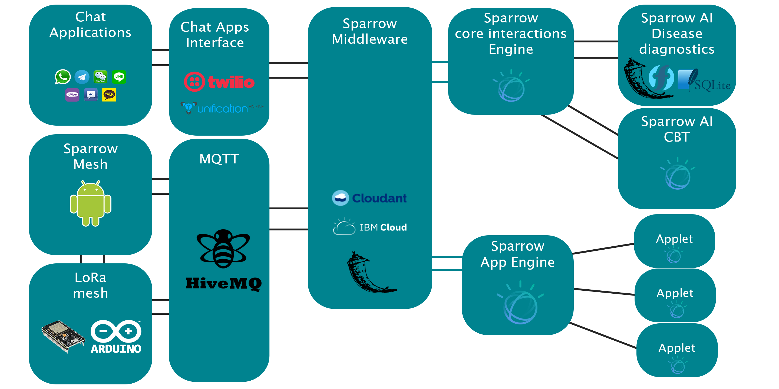
Architecture overview
Sparrow Net
Sparrow Engine
Sparrow AI/Applets

Slide 17
Connectivity

Slide 18
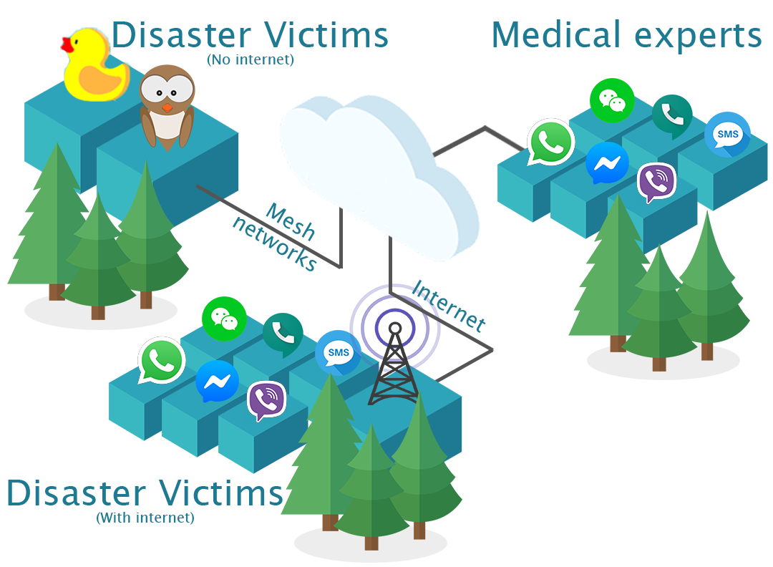
Sparrow Net

Slide 19
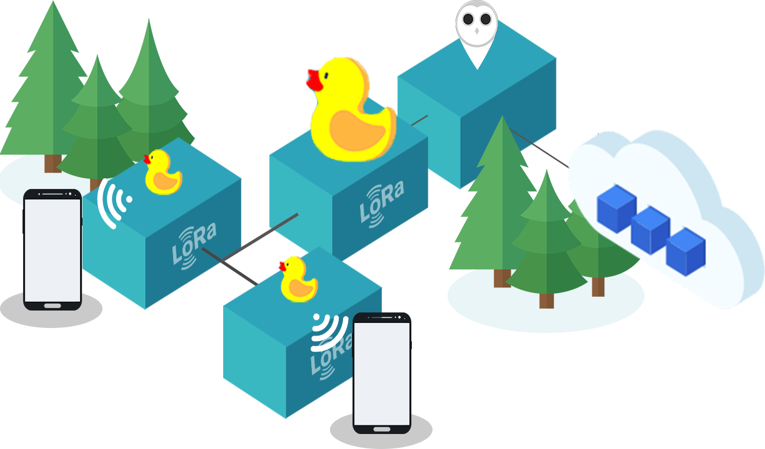
Sparrow Net
LoRa IoT
‘Clusterduck’
Smartphone
Nearest Duck (Mama)
Intermediate Duck (n) - Mama
Internet enabled duck (Papa)

Slide 20
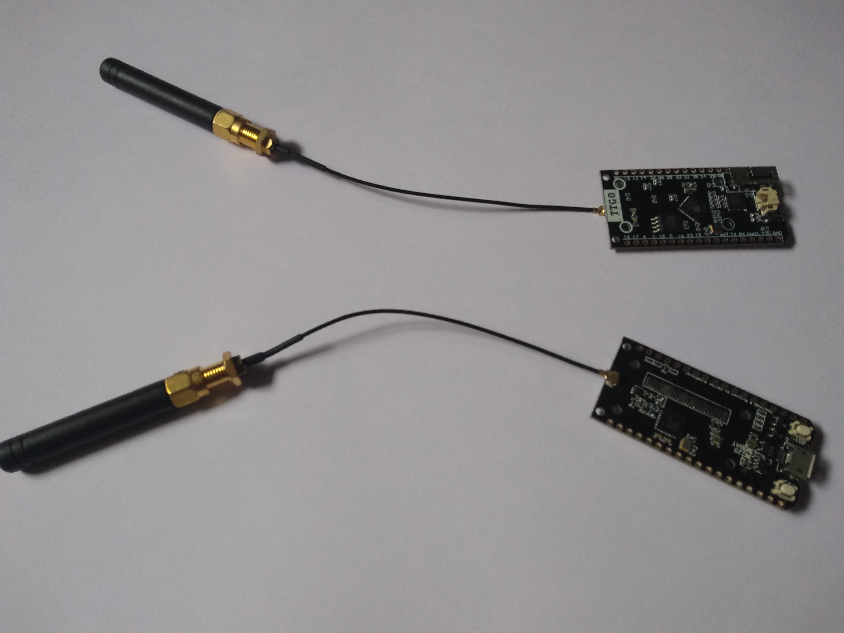
ESP32 with LoRa shield
ESP32
<1$ per duck
Inbuilt Wifi, BLE and Bluetooth
Ultra low power (Solar powered ducks)
Industry grade durability (-50 to 50 Celcius)
‘Ducks’
Clusterduck
4 mamas + 1 papa per 8sqKm (5$)
20Kbps for 50 devices

Slide 21
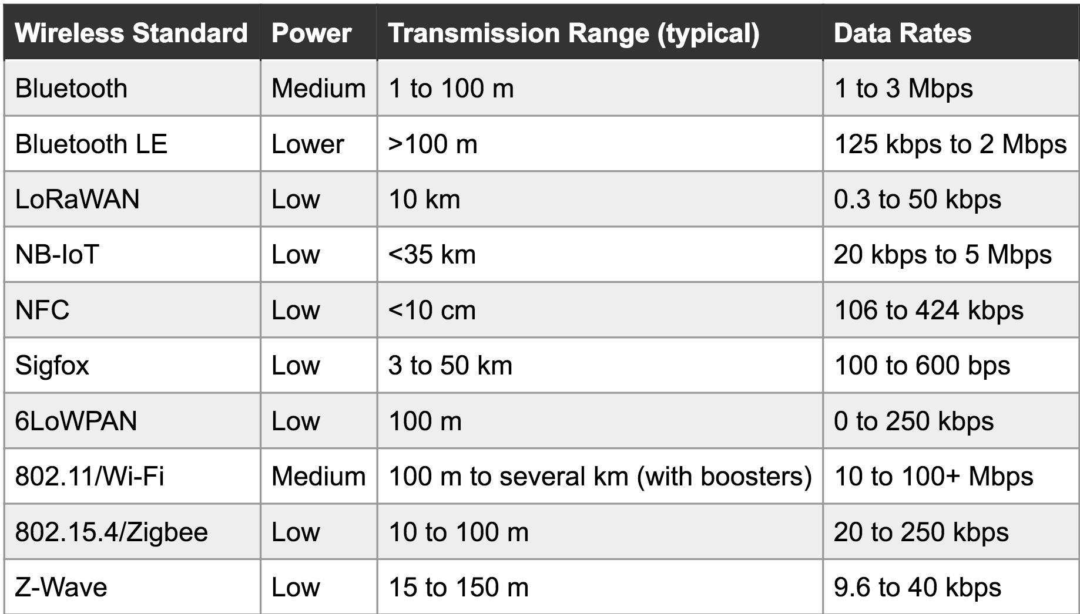
IoT protocols comparison

Slide 22
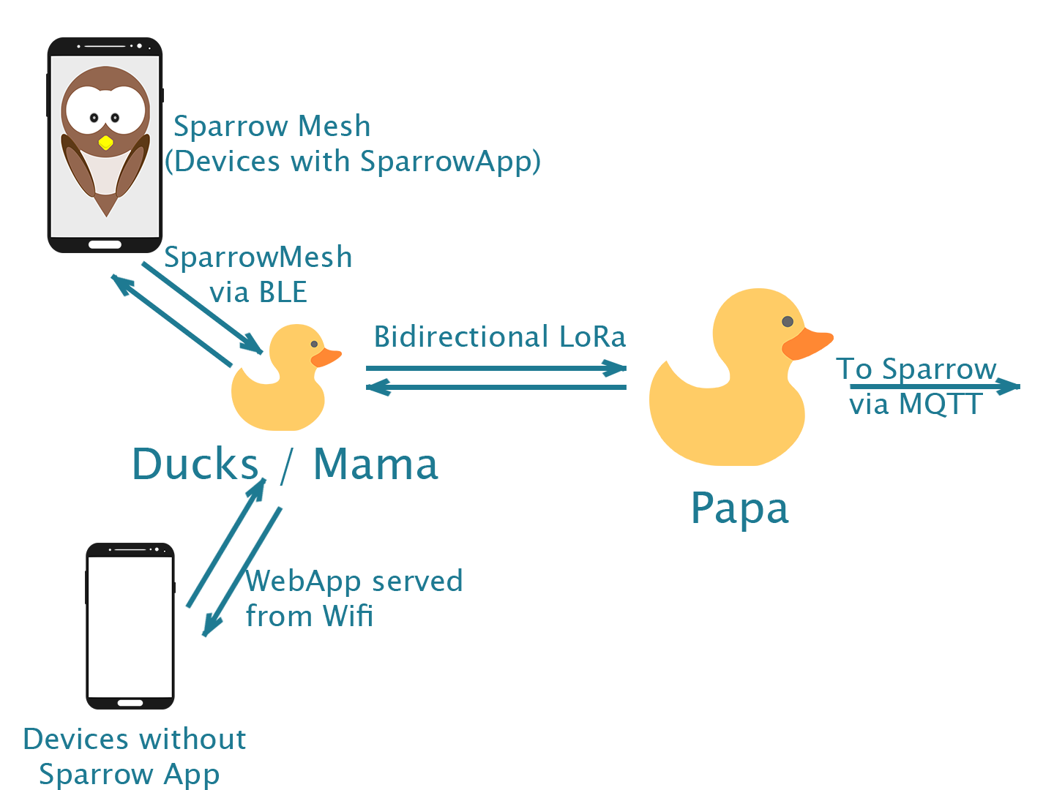
‘Clusterduck’

Slide 23
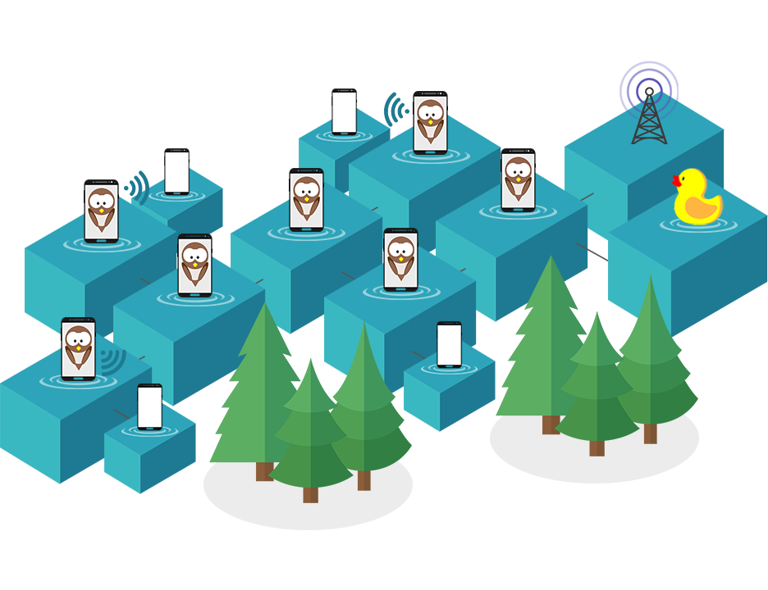
Sparrow Net
Smartphones

Slide 24
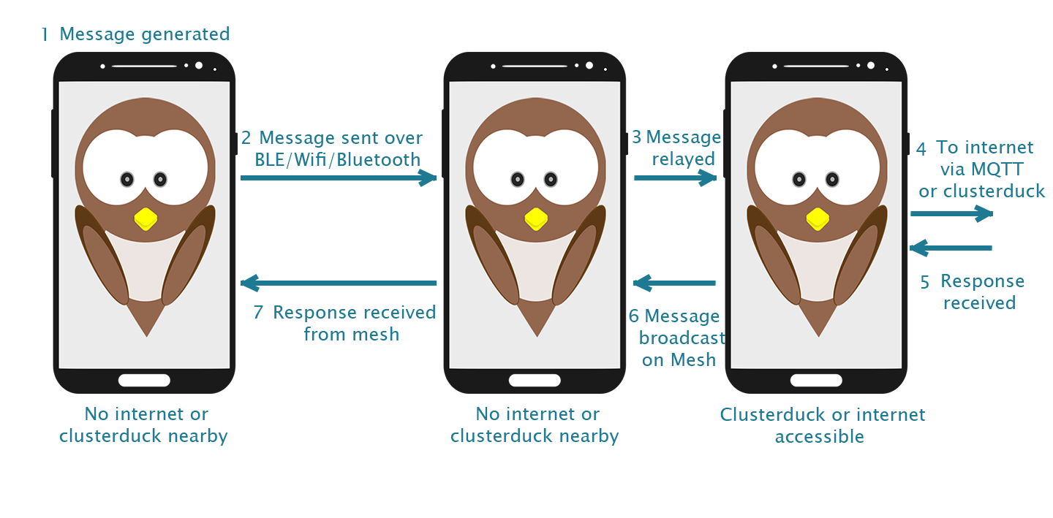
Smartphone mesh

Slide 25
Clusterduck link

Slide 26
AODV Protocol
Discovery message
All devices maintain
Neighbors List
(5 mins TTL)
Ack
Messages buffer (1 day TTL)
Available message keys
A
Available message keys
B
All devices broadcast
Message buffer
Discovery message
Message buffer
Message buffer
Ack
Ack

Slide 27
A
AODV Protocol
B
C

Slide 28
Sparrow Smartphone Application
BLE-Wifi-Bluetooth discovery service (Neighbors list refresh) – Client + Server
MQTT client (To sync with server) - Client
Memory cleaner
Nearby Messages sync service (Messages buffer sync with neighbor) – Client + server
Duck
BLE-Wifi discovery service (Neighbors list refresh) – Client + Server
(Papa only) MQTT client (To sync with server) - Client
Memory cleaner
Nearby Messages sync service (Messages buffer sync with neighbor) – Client + server
LoRa discovery service – Client + server
LoRa message sync service – Client + server
Webserver to serve Wifi login end point

Slide 29
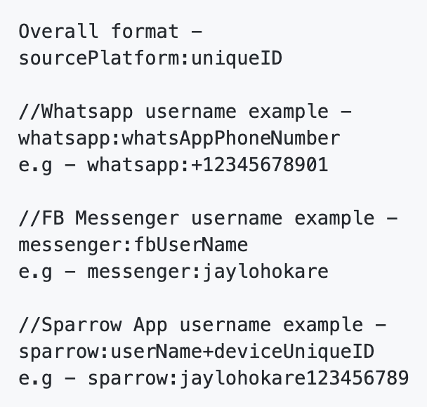
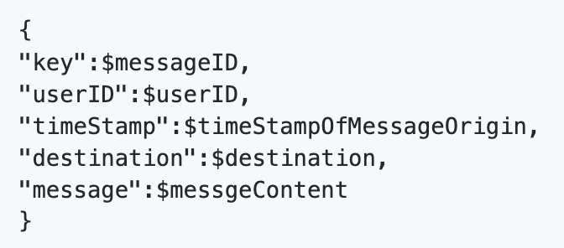
Device IDs
Mesh messages format

Slide 30
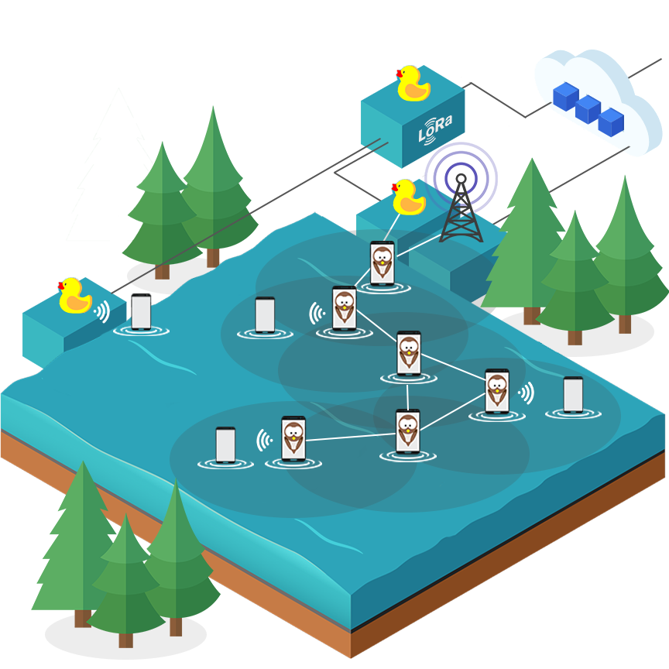
Sparrow Net
Mesh Networks

Slide 31
Sparrow Applets

Slide 32
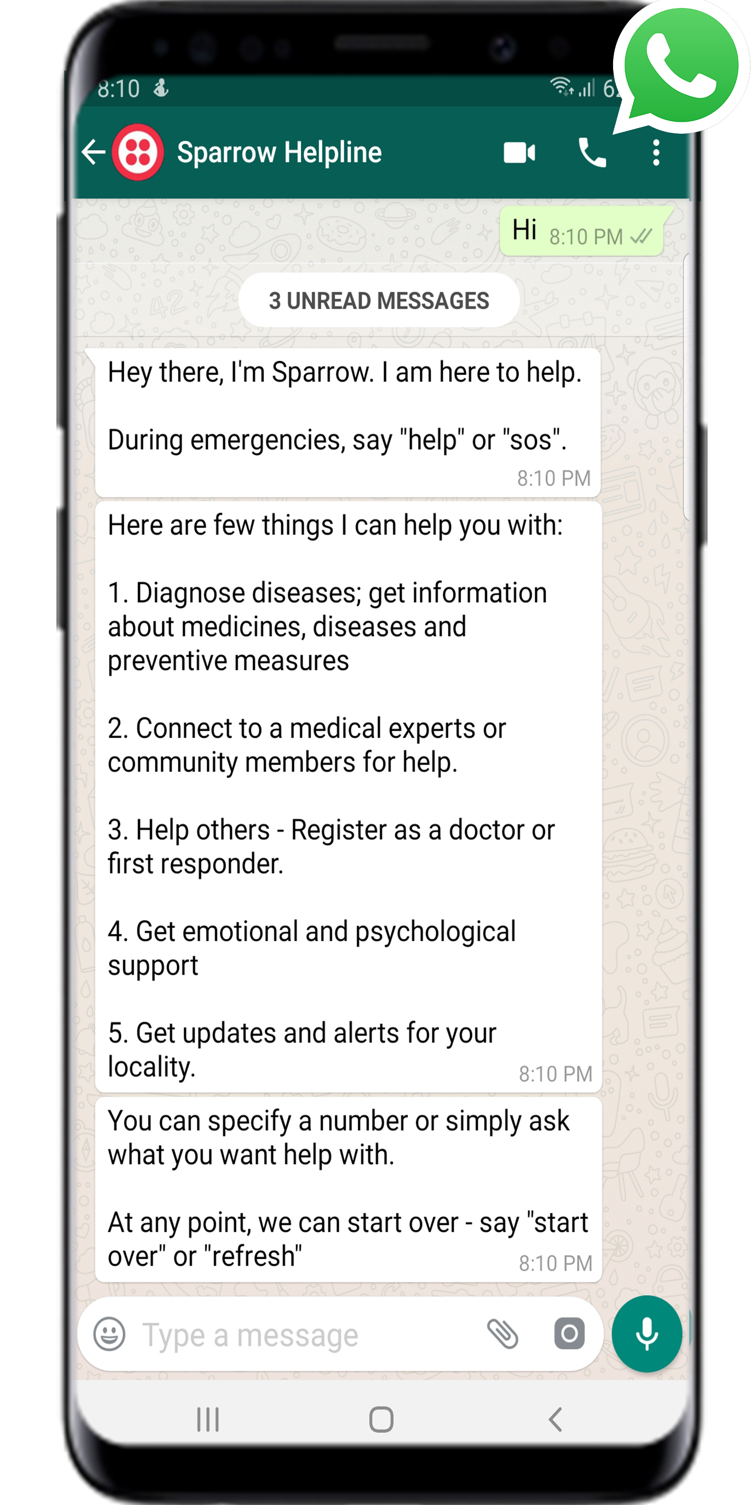
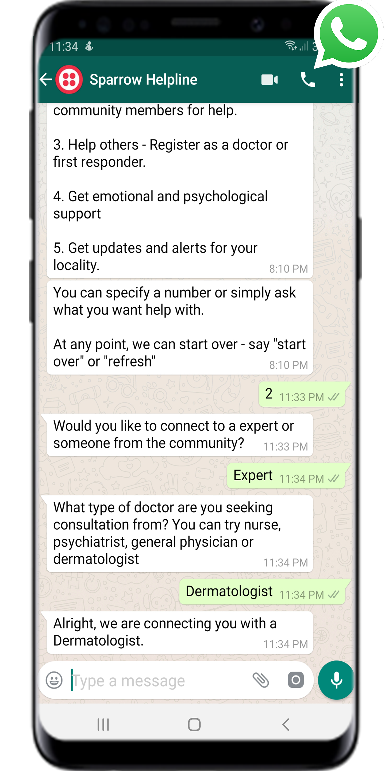
Live Screenshots

Slide 33
“Uber for medical help”
Disaster Victims
Chat apps
Twilio
Sparrow Middleware
(Flask App)
Doctors
Ducks
MQTT Server
Twilio
Chat apps
Sparrow Mesh

Slide 34
Sparrow Applets
Victims
Chat apps
Twilio
Sparrow Middleware
(Flask App)
Twilio
Chat apps
Doctors
App 1
Ducks
MQTT Server
App 2
Sparrow Mesh
App 3

Slide 35
Message flow from user to Applets
Sparrow middleware
(Inwards connection)
Context parser
Sparrow AI
Sparrow middleware
(Outwards connection)
Message from
Sparrow Net
Connect to expert handler
Send message
To recipient
Sparrow Applets
Configure through Sparrow
Context parse: Key words / Phrases to trigger Sparrow Applet
Outwards connection: Alexa app / Google assistant / Custom chatbot handler

Slide 36
Sparrow Community

Slide 37
Where are we today?
Sparrow Platform is Non-profit organization
Community of 50 doctors (and growing)
5 developers (USA-India-China)
Linux foundation project

Slide 38

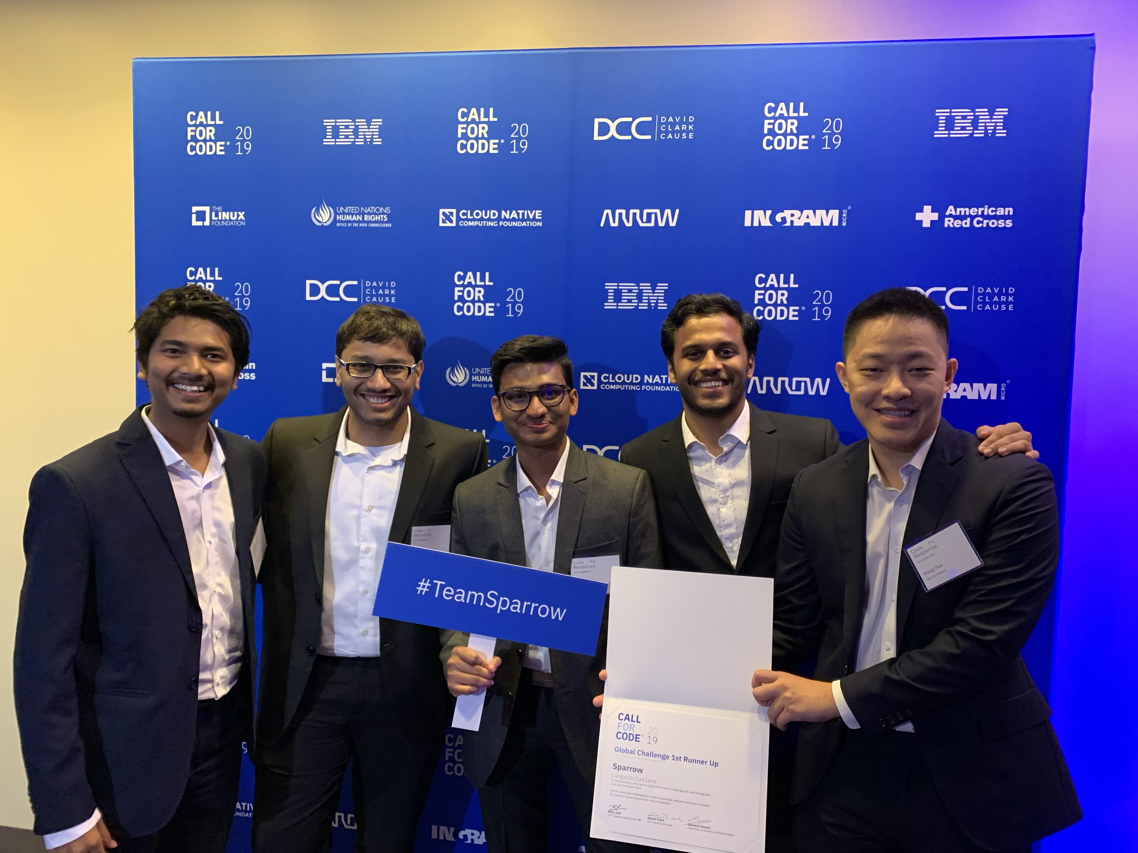
Any questions?
https://github.com/sparrow-platform
https://www.sparrow-platform.com

